Slide 1


Slide 2






Team
01
02
03
Abigail
Zothandwa
Aphiwe
Manager / Data Analyst
Data Modeler
Data Scientist
04
05
06
Velly
Mapule
Gomolemo
Developer / Data Engineer
Quantitative analyst
Machine learning engineer

Slide 3

Build a movie recommender system that is capable of predicting how a user will rate a movie they have not yet viewed based on a range of relevant data including their historical interaction/rating data and movie data.

Slide 4
TOPICS
Presentation Overview
02
MODELLING &
PERFORMANCE
03
APPLICATION DEMOSTRATION
01
04
EDA & ENGINEERING
CONCLUSION

Slide 5
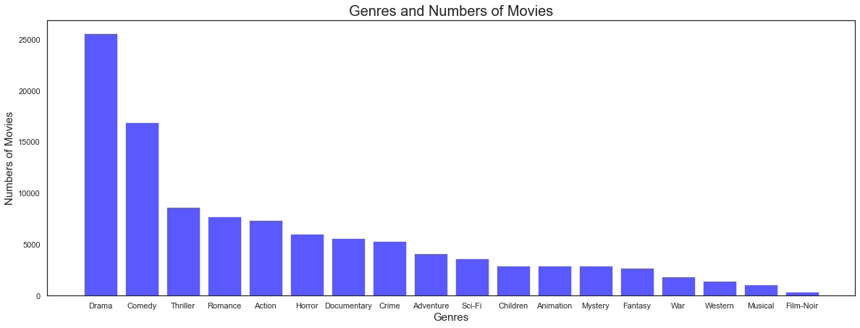
Exploratory Data Analysis
Bar Graph Showing the Count of Sentiments from the Tweets

Slide 6
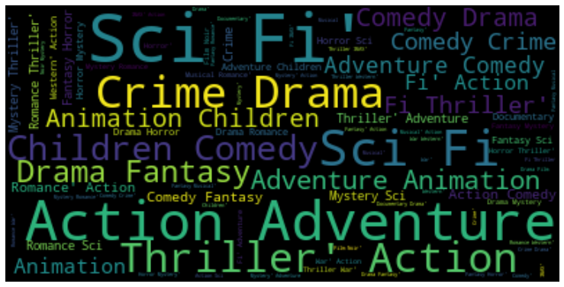
Exploratory Data Analysis
Wordcloud Showing Movie Gengres that are Mostly Watched

Slide 7
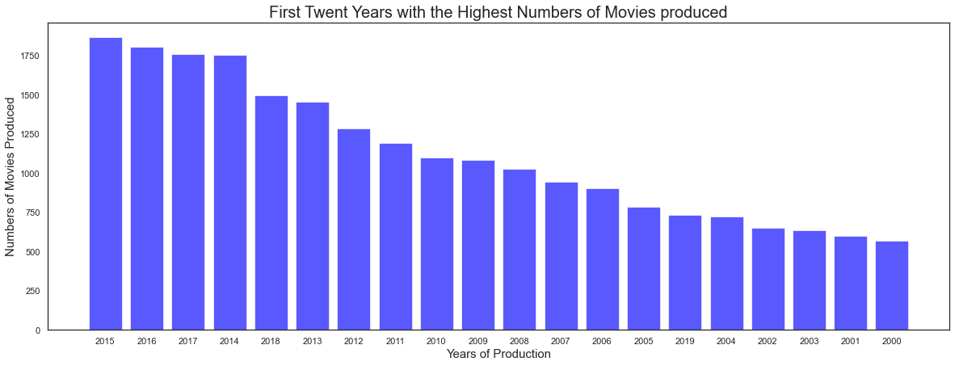
Exploratory Data Analysis

Slide 8
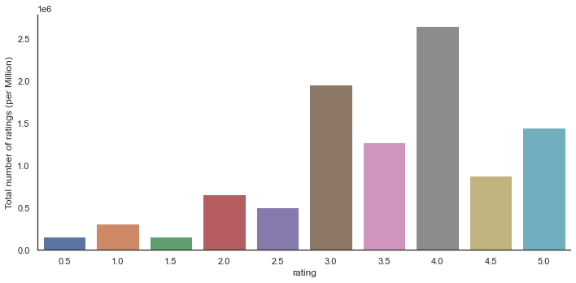
Exploratory Data Analysis

Slide 9
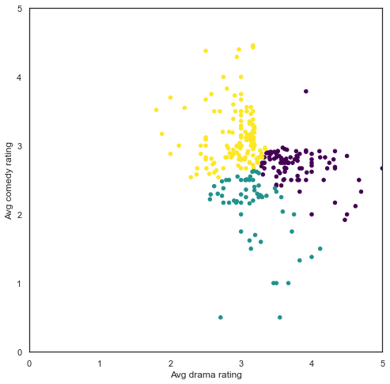
Exploratory Data Analysis

Slide 10
Data Engineering
Pre Processing
New
Features
Data engineering is the process of designing and building systems for collecting, storing and analysing data at scale.

Slide 11
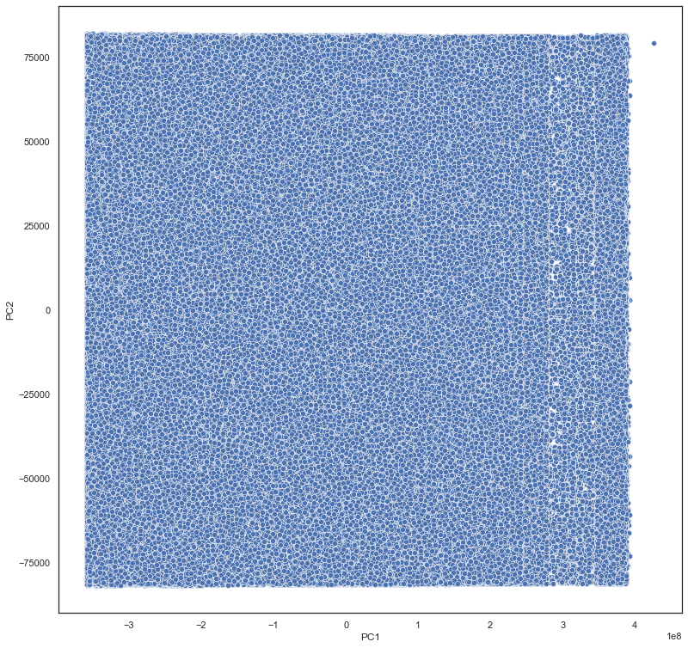
Feature Engineering
PCA before scaling

Slide 12
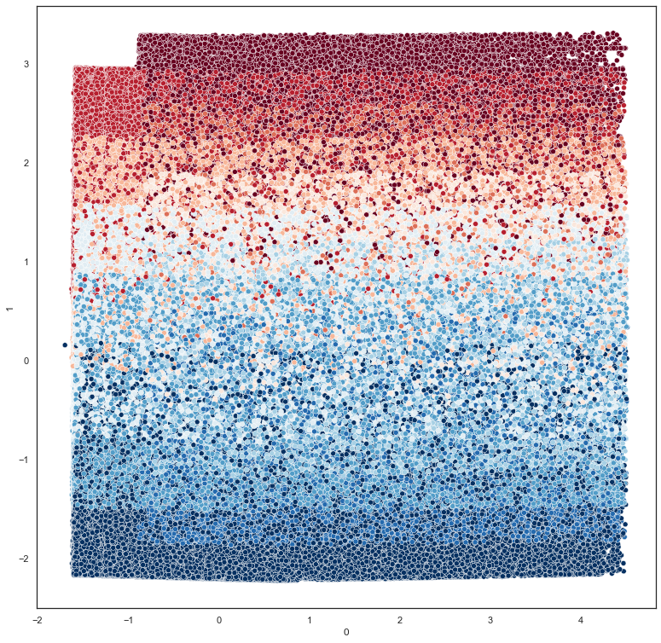
Feature Engineering
PCA after scaling

Slide 13
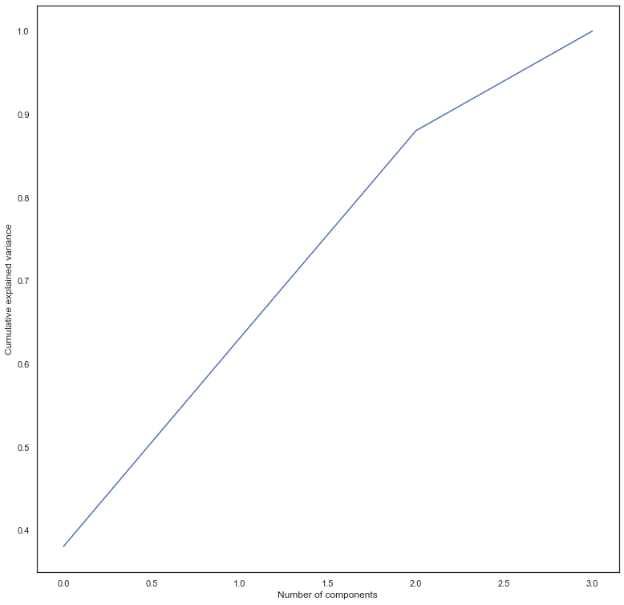
Feature Engineering
cumulative variance explained

Slide 14
Modelling
KNN
Baseline
Singular Value Decomposition
Non-negative Matrix Factorization (NMF) Singular value
Normal
Predictor

Slide 15
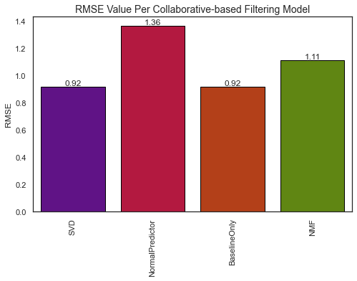
Model Performance

Slide 16
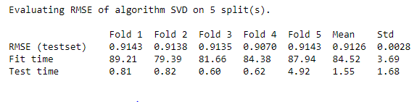
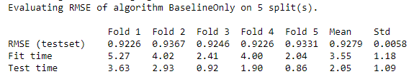
Model Performance
Cross Validation
We used the K-fold technique to perform cross validation .

Slide 17




Our App

Slide 18

Our App

Slide 19
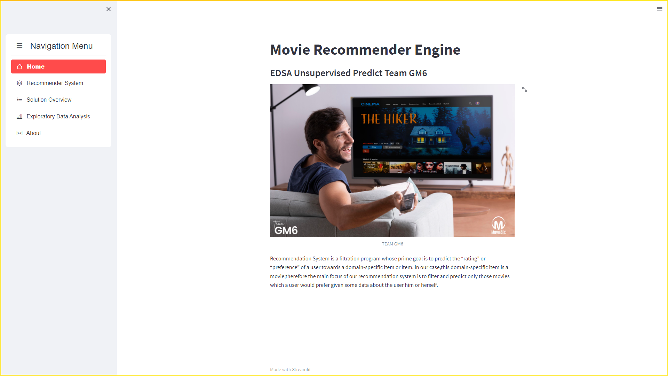

Slide 20
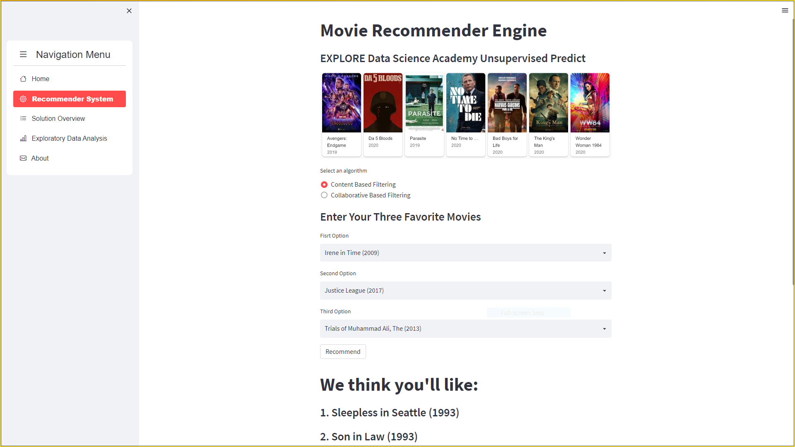

Slide 21
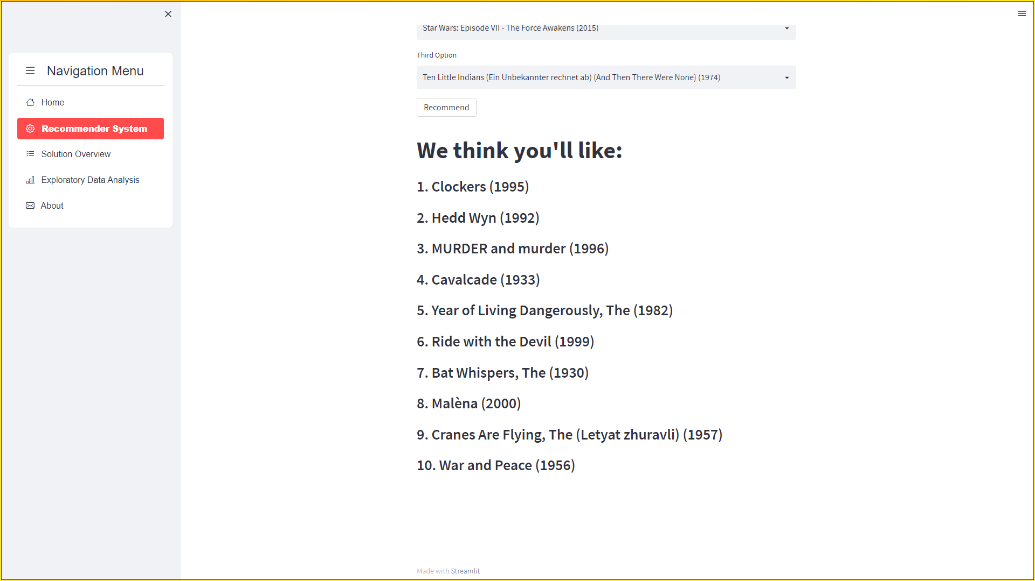

Slide 22
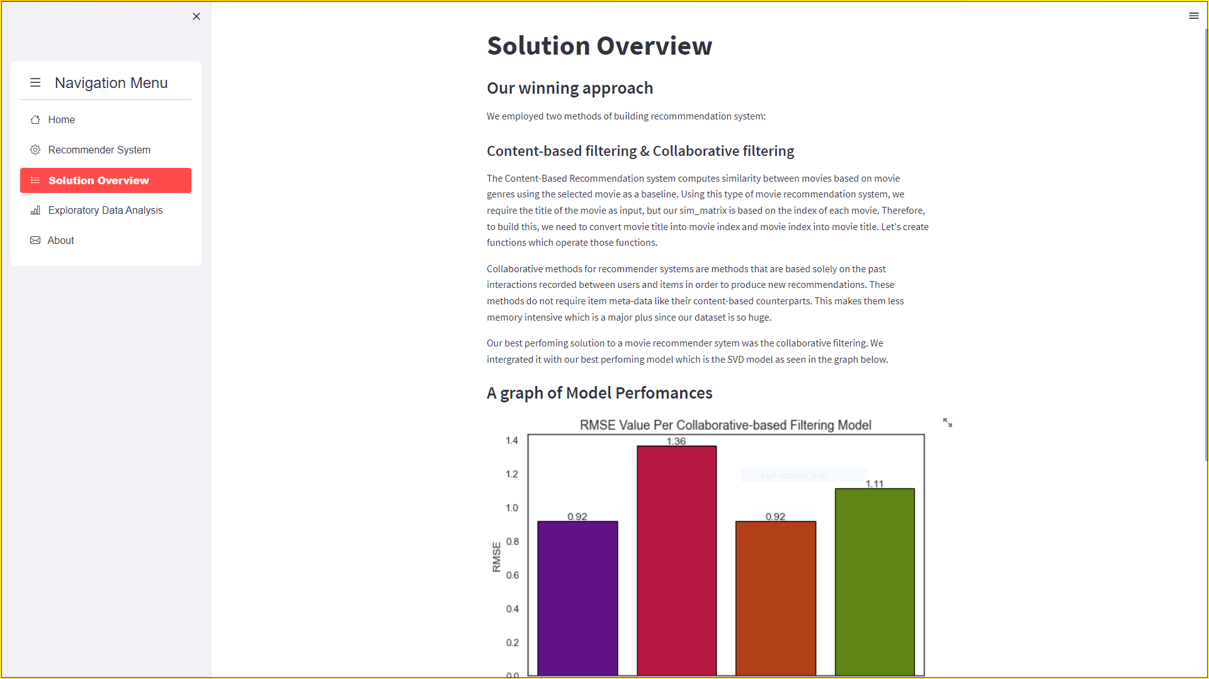

Slide 23
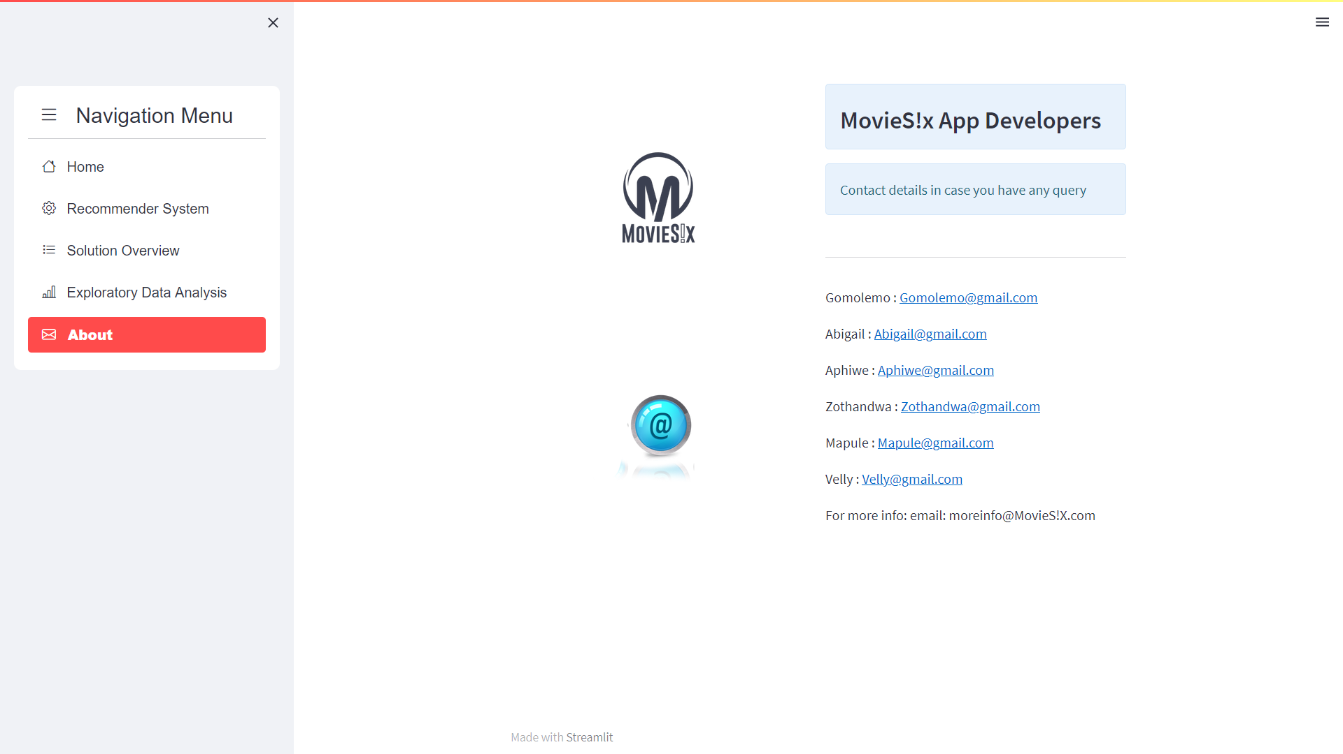

Slide 24

Thanks for Listening with great patience
Questions Time

